Slide 1
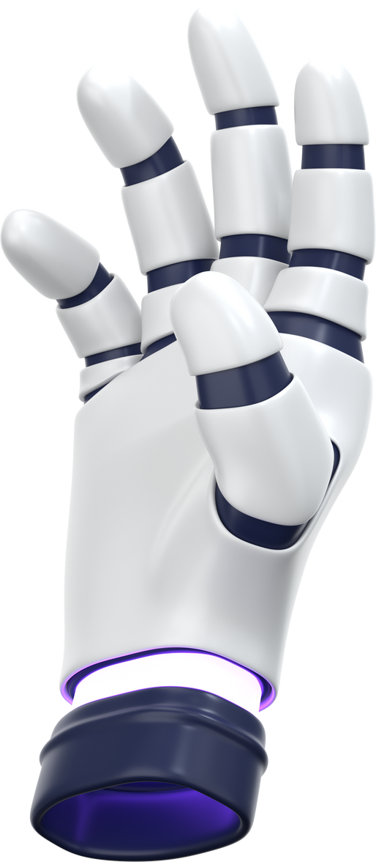
FLOOD DETECTION USING DEEP LEARNING
COURSE PROJECT ON APPLYING CNNS TO DISASTER DETECTION
TEAM: AMRUTHA GOWRI JAYASIMHA HANUMESH, YESESWINI CHANDANA, SAI KIRAN CHILLIMUNTHA
TOOLS: PYTHON, PYTORCH, GOOGLE COLAB, KAGGLE FLOODIMG DATASET

Slide 2


MOTIVATION & PROBLEM STATEMENT
FLOODS CAUSE LARGE-SCALE DAMAGE AND HUMAN DISPLACEMENT WORLDWIDE.
SOCIAL MEDIA AND DRONE IMAGES ARE AVAILABLE QUICKLY DURING DISASTERS.
\
GOAL: AUTOMATICALLY DETECT WHETHER AN IMAGE SHOWS FLOODED OR NON-FLOODED SCENES.
BUILD AND COMPARE DEEP LEARNING MODELS FOR THIS BINARY CLASSIFICATION TASK.

Slide 3

DATASET OVERVIEW
Source: FloodIMG dataset from Kaggle.
After cleaning and skipping corrupted images:
Total images: 7,526
Flooded: 7,492
Non-flooded: 34
Images resized to 224×224 and normalized with ImageNet statistics.
Train/Validation/Test split: 70/20/10.
MACHINE LEARNING

Slide 4

EXTREME CLASS IMBALANCE
The dataset is highly skewed towards flooded scenes.
About 99.55% flooded vs 0.45% non-flooded images.
A trivial model that always predicts “flooded” already reaches ~99.7% accuracy.
Therefore, we focus on ROC-AUC and minority-class metrics, not just accuracy.

Slide 5

SAMPLE IMAGES
Flooded examples show:
Submerged vehicles
Houses with water up to doors/windows
Damaged roads and infrastructure
Very few non-flooded examples, mostly normal roads/buildings.
Visual inspection confirms that flood cues are clear but diverse.

Slide 6

PREPROCESSING & DATA PIPELINE
Used PyTorch ImageFolder for loading images.
Transforms (Train):
Random horizontal flip, rotation, brightness/contrast jitter.
Transforms (Val/Test):
Resize + center crop + normalization only.
Dataloaders created for train, validation, test with batch size 32.

Slide 7
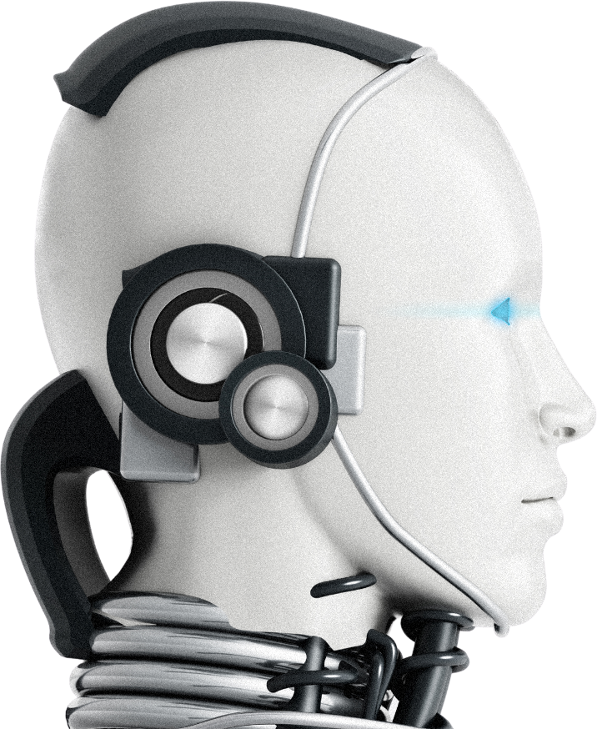
BASELINE CNN ARCHITECTURE
Custom CNN implemented in PyTorch:
Conv2d (32 filters) → ReLU → MaxPool
Conv2d (64 filters) → ReLU → MaxPool
Flatten → Fully connected (128 units) → ReLU
Final fully connected layer → 1 output (logit)
Loss: BCEWithLogitsLoss
Optimizer: Adam, LR = 0.001
Training: 5 epochs, batch size 32.
Virtual Assistants
03.
Recommendation Systems
04.
Healthcare Tools

Slide 8

BASELINE CNN TRAINING RESULTS
Train accuracy quickly reached ≈ 0.9947, validation accuracy ≈ 0.9973.
Training and validation loss both decreased smoothly over 5 epochs.
Validation ROC-AUC values were in the 0.35–0.64 range due to very few non-flooded samples in the validation set.
Indicates good fit to the majority class but unstable behaviour on minority examples.

Slide 9

BASELINE CNN TEST PERFORMANCE
Test Accuracy: ~0.997 (similar to majority baseline).
Test ROC-AUC: 0.83 – much higher than random (0.5).
This means the CNN has learned meaningful visual features for floods.
However, because the test set has very few non-flooded images,
precision, recall, and F1 for that class are still unstable and can drop to 0 if the model misses them.

Slide 10
TRANSFER LEARNING WITH RESNET-50
Used pretrained ResNet-50 (ImageNet) as backbone.
Replaced final fully connected layer for binary classification.
Earlier layers initially frozen, then fine-tuned on FloodIMG.
Same preprocessing, split, and metrics as the baseline.
Virtual Assistants
03.
Recommendation Systems
04.
Healthcare Tools

Slide 11
RESNET-50: TRAINING VS TEST
On training/validation:
Train accuracy up to 0.9983, validation accuracy around 0.991–0.997.
Validation ROC-AUC between 0.80–0.88, looking very strong.
On the test set, however:
Accuracy = 0.9973 (again very high).
Precision, Recall, F1 = 0.0 for the minority class.
ROC-AUC dropped to 0.40, worse than random.
Interpretation: the ResNet-50 model predicts almost everything as “flooded” and fails to identify non-flooded images.

Slide 12
MODEL COMPARISON
Compared three models on the test set:
Majority Baseline (always “flooded”)
Baseline CNN
ResNet-50 Transfer Learning
All have similar accuracy (~0.997) due to heavy imbalance.
ROC-AUC differentiates them:
Majority baseline: 0.50 (random).
Baseline CNN: 0.835 (best).
ResNet-50 TL: 0.400 (overfits majority class).
Conclusion: Baseline CNN is the most useful model despite having the same accuracy, because it offers better class separation.
MACHINE LEARNING

Slide 13
CHALLENGES
KAGGLE API 403 ERRORS WHEN DOWNLOADING FLOODIMG; REQUIRED CONFIGURING KAGGLE.JSON CORRECTLY.
RESTRUCTURING DATASET INTO FLOODED/ AND NON-FLOODED/ FOLDERS FOR PYTORCH IMAGEFOLDER.
HANDLING CORRUPTED IMAGES THAT COULD NOT BE LOADED.
DEALING WITH EXTREME CLASS IMBALANCE AND MISLEADING ACCURACY.
OCCASIONAL COLAB GPU TIME LIMITS AND LONG TRAINING RUNS, ESPECIALLY WITH RESNET-50.

Slide 14
CONCLUSIONS & FUTURE WORK
We implemented and compared two deep learning approaches for flood detection.
Baseline CNN achieved the best balance with ROC-AUC ≈ 0.83 on the test set.
Transfer learning with ResNet-50 looked strong on validation, but failed on the test set due to class imbalance and overfitting.
Future improvements:
Class-weighted or focal loss, oversampling non-flooded images.
Trying other architectures (EfficientNet, ViT) with better imbalance handling.
Generating Grad-CAM visualizations to show what the network focuses on.
Building a simple web interface to upload images and get flood predictions.

Slide 15
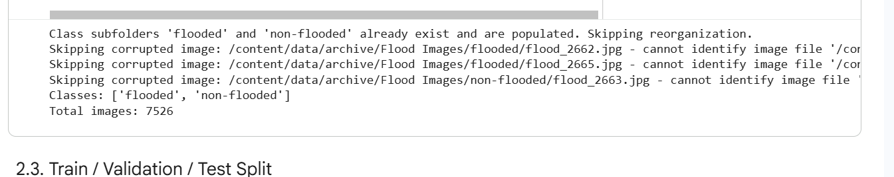
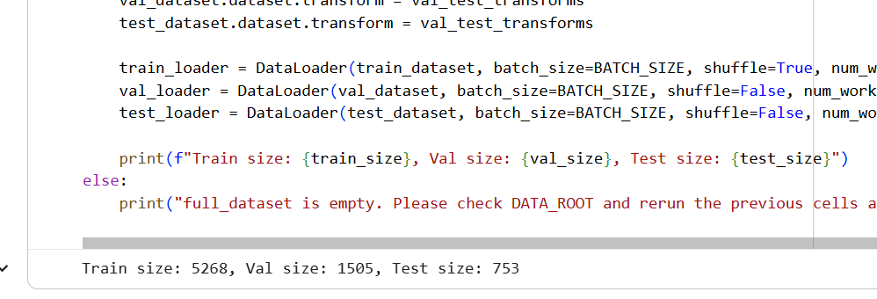
SCREENSHOTS
DATASET DETAIILS ABOVE

Slide 16
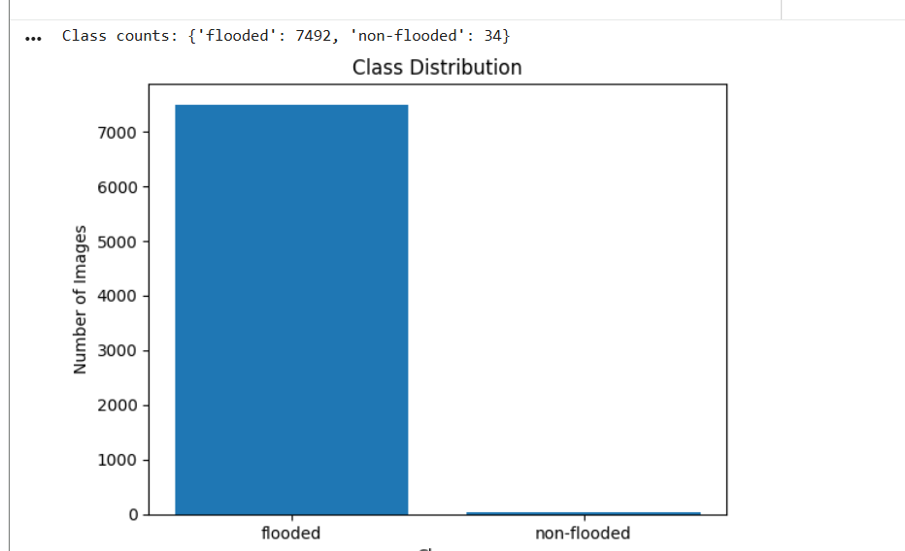
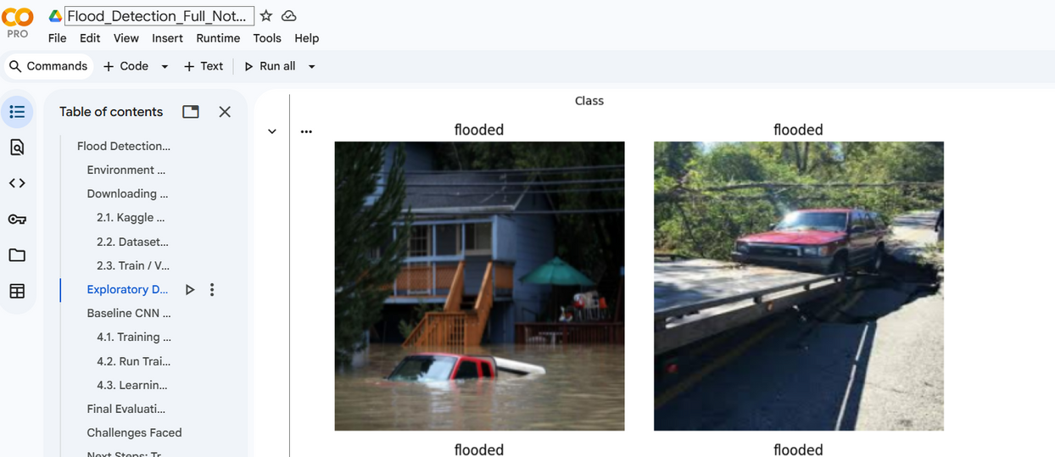

Slide 17
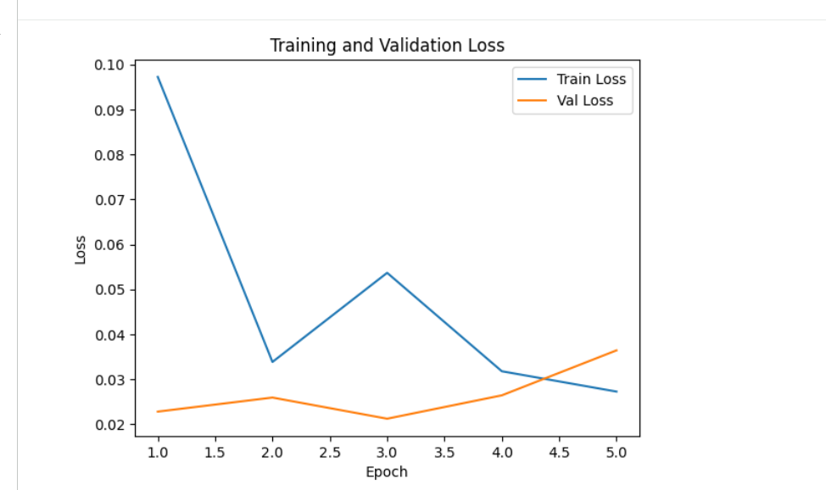
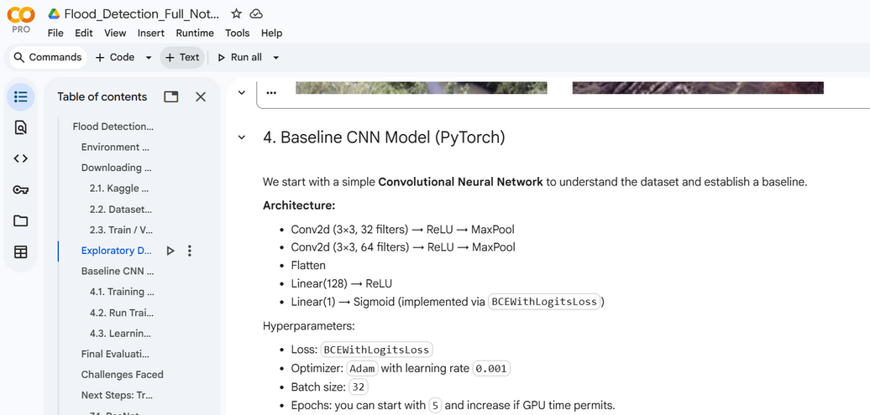
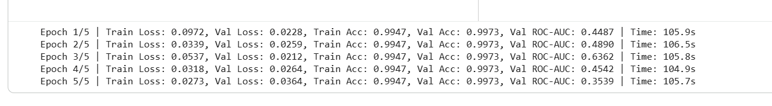
TRAINING ACCURACY OF 99.7%

Slide 18
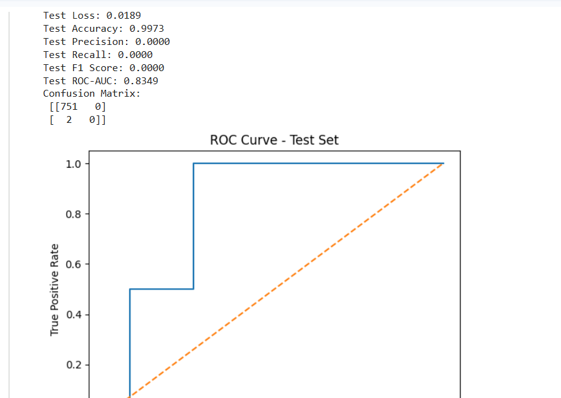
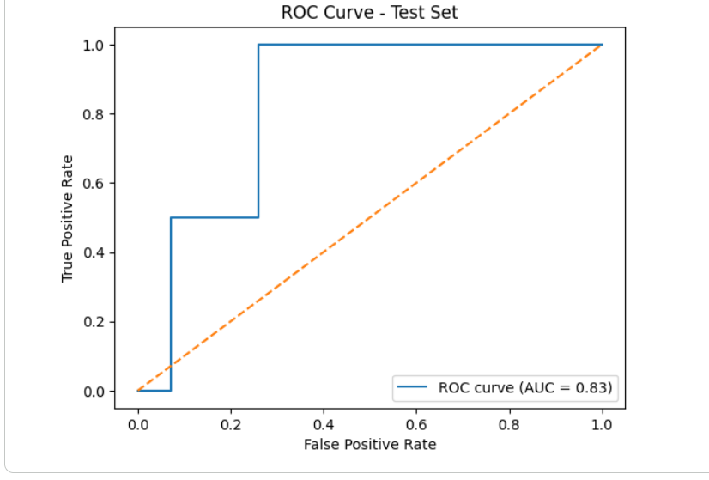

Slide 19
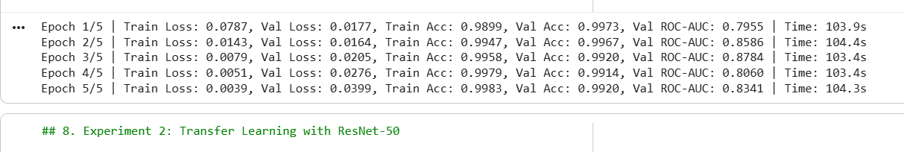
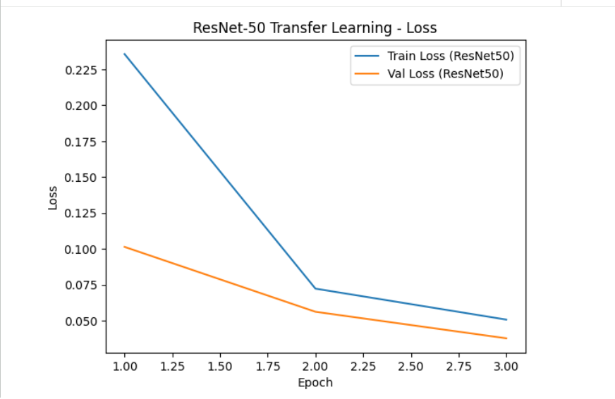

Slide 20
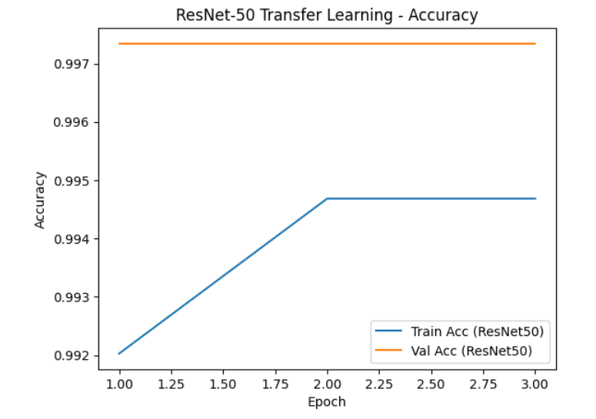

Slide 21
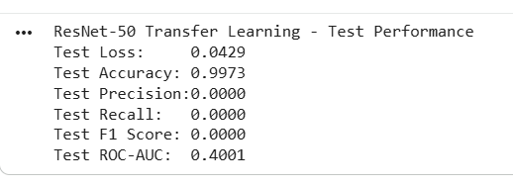
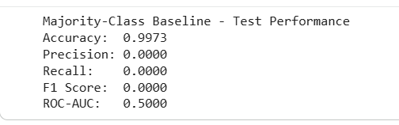
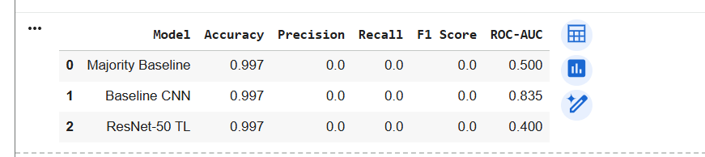

Slide 22

THANK YOU

